Slide 1
Chapter 3- C operators & Expression
An operator is a symbol that tells the compiler to perform specific mathematical or logical functions.
C language is rich in built-in operators and provides the following types of operators −
(1). Arithmetic Operators
(2). Relational Operators
(3). Logical Operators
(4). Assignment Operator
(5). Conditional operator
(6). Increment/decrement operator (Unary operator)
(7). Bitwise operator
(8). Special operator

Slide 2
Arithmatic operators
The following table shows all the arithmetic operators supported by the C language. Assume variable A holds 10 and variable B holds 20, then −
Operator | Description | Example
+ | Adds two operands. | A + B = 30
− | Subtracts second operand from the first. | A − B = -10
* | Multiplies both operands. | A * B = 200
/ | Divides numerator by de-numerator. | B / A = 2
% | Modulus Operator and remainder of after an integer division. | B % A = 0

Slide 3
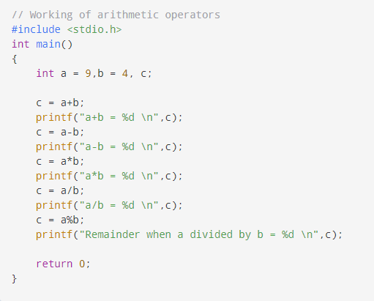
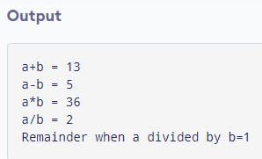
Arithmatic operators - example

Slide 4
Relational operators Relational operators are used in decision making and loops. The following table shows all the relational operators supported by C. Assume variable A holds 10 and variable B holds 20 then −
Operator | Description | Example
== | Checks if the values of two operands are equal or not. If yes, then the condition becomes true. | (A == B) is not true.
!= | Checks if the values of two operands are equal or not. If the values are not equal, then the condition becomes true. | (A != B) is true.
> | Checks if the value of left operand is greater than the value of right operand. If yes, then the condition becomes true. | (A > B) is not true.
< | Checks if the value of left operand is less than the value of right operand. If yes, then the condition becomes true. | (A < B) is true.
>= | Checks if the value of left operand is greater than or equal to the value of right operand. If yes, then the condition becomes true. | (A >= B) is not true.
<= | Checks if the value of left operand is less than or equal to the value of right operand. If yes, then the condition becomes true. | (A <= B) is true.

Slide 5
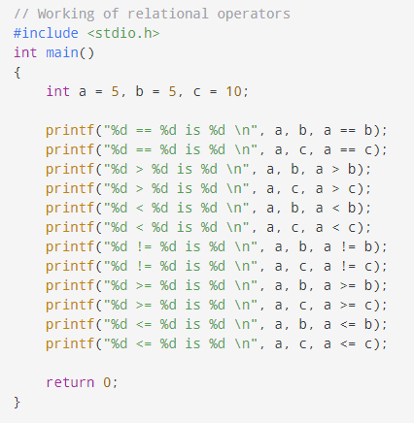
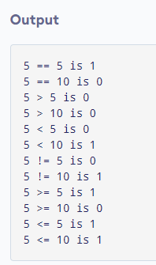
Relational operator- example 1

Slide 6
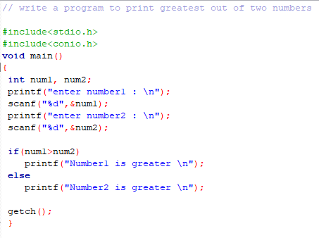
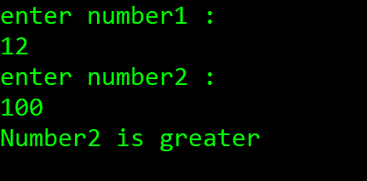
Relational operator - example 2
Output :

Slide 7
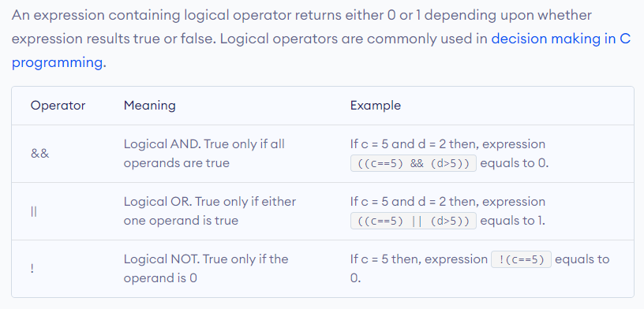
Logical operators

Slide 8
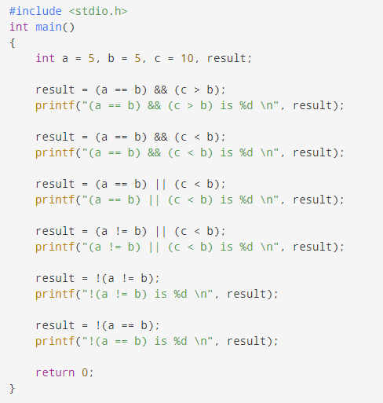
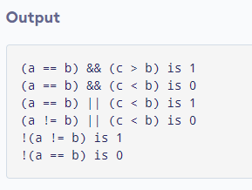
Logical operators – example 1

Slide 9
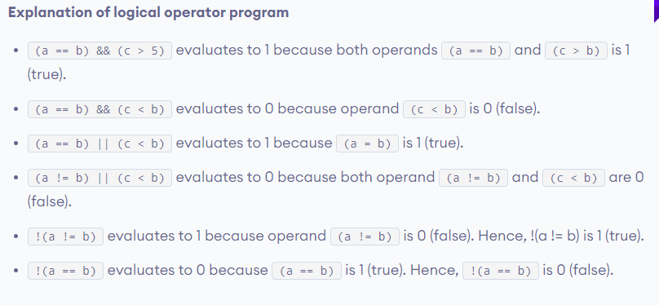

Slide 10
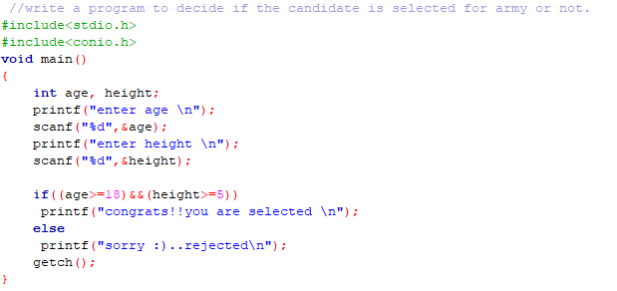
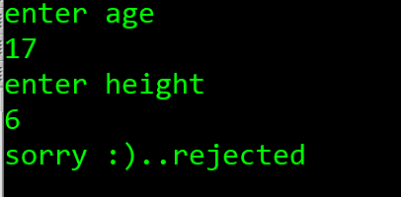
Logical operator example -2
Output :

Slide 11
Assignment operators
Operator | Description | Example
= | Simple assignment operator. Assigns values from right side operands to left side operand | C = A + B will assign the value of A + B to C
+= | Add AND assignment operator. It adds the right operand to the left operand and assign the result to the left operand. | C += A is equivalent to C = C + A
-= | Subtract AND assignment operator. It subtracts the right operand from the left operand and assigns the result to the left operand. | C -= A is equivalent to C = C - A
*= | Multiply AND assignment operator. It multiplies the right operand with the left operand and assigns the result to the left operand. | C *= A is equivalent to C = C * A
/= | Divide AND assignment operator. It divides the left operand with the right operand and assigns the result to the left operand. | C /= A is equivalent to C = C / A
%= | Modulus AND assignment operator. It takes modulus using two operands and assigns the result to the left operand. | C %= A is equivalent to C = C % A

Slide 12
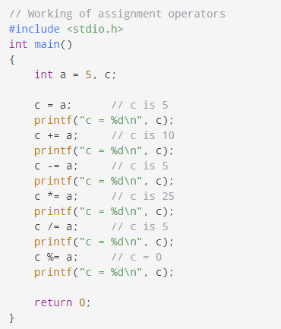
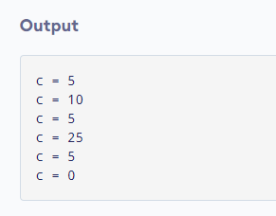
Assignment operators – example 1

Slide 13
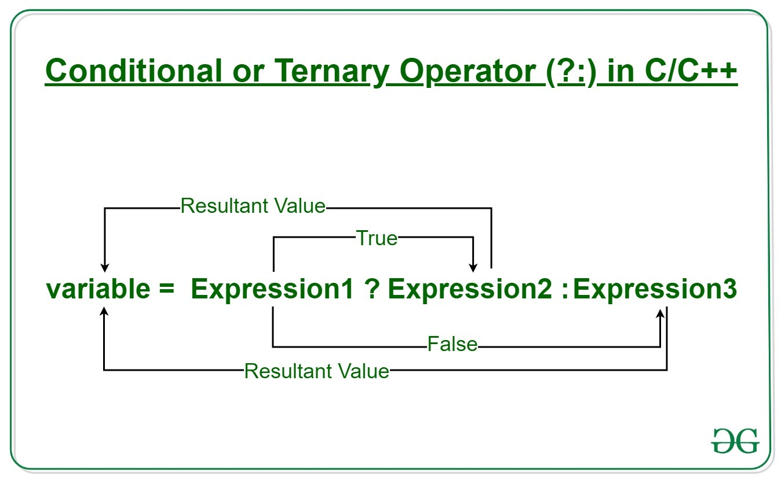
Conditional operator
The conditional operator is kind of similar to the if-else statement as it does follow the same algorithm as of if-else statement but the conditional operator takes less space and helps to write the if-else statements in the shortest way possible.

Slide 14
Example 1
Since the Conditional Operator ‘?:’ takes three operands to work, hence they are also called ternary operators.
// C program to find largest among two // numbers using ternary operator #include <stdio.h> int main() { int m = 5, n = 4; (m > n) ? printf("m is greater than n that is %d > %d", m, n) : printf("n is greater than m that is %d > %d", n, m); return 0; }
Output :
m is greater than n that is 5>4

Slide 15
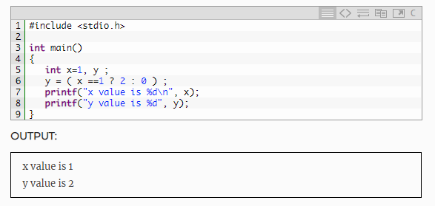
Example 2

Slide 16
Increment and Decrement Operators
C programming has two operators increment ++ and decrement -- to change the value of an operand (constant or variable) by 1.
Increment ++ increases the value by 1 whereas decrement -- decreases the value by 1. These two operators are unary operators, meaning they only operate on a single operand.

Slide 17
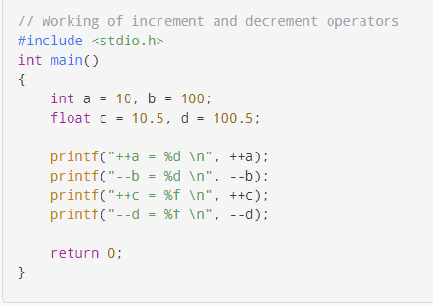
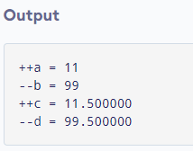
Increment and Decrement Operators – example

Slide 18
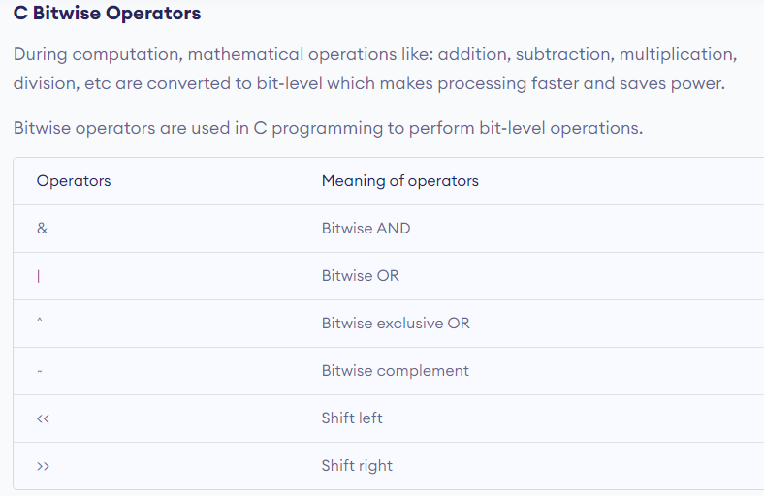

Slide 19
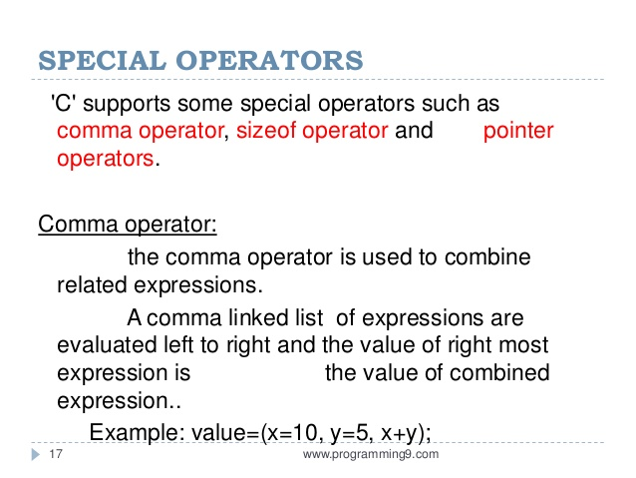


Slide 20
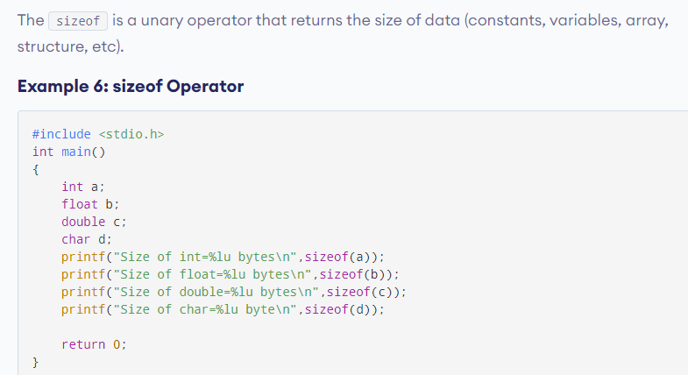
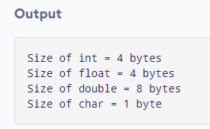
Size of operator

Slide 21
Operators Precedence in C
Operator precedence determines the grouping of terms in an expression and decides how an expression is evaluated. Certain operators have higher precedence than others; for example, the multiplication operator has a higher precedence than the addition operator.
For example, x = 7 + 3 * 2; here, x is assigned 13, not 20 because operator * has a higher precedence than +, so it first gets multiplied with 3*2 and then adds into 7.
Here, operators with the highest precedence appear at the top of the table, those with the lowest appear at the bottom. Within an expression, higher precedence operators will be evaluated first.

Slide 22
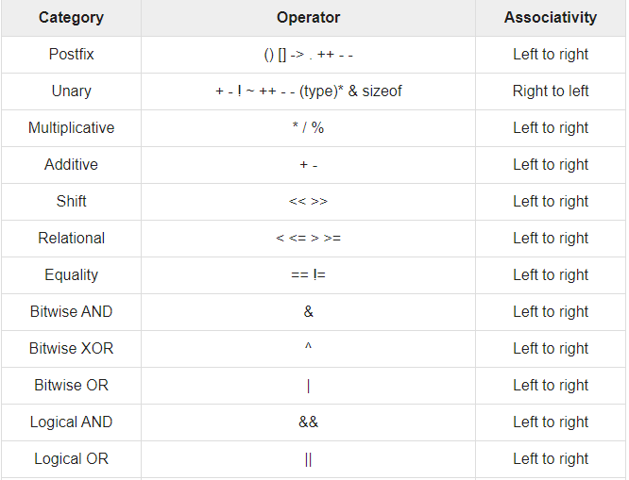
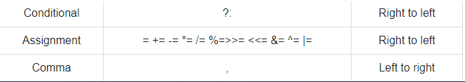

Slide 23
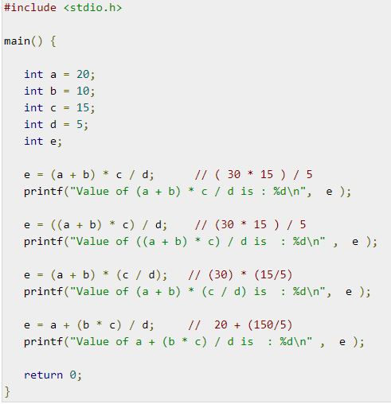
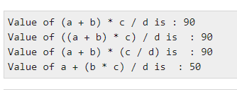
Operator precedence - example
Output :

